Slide 1
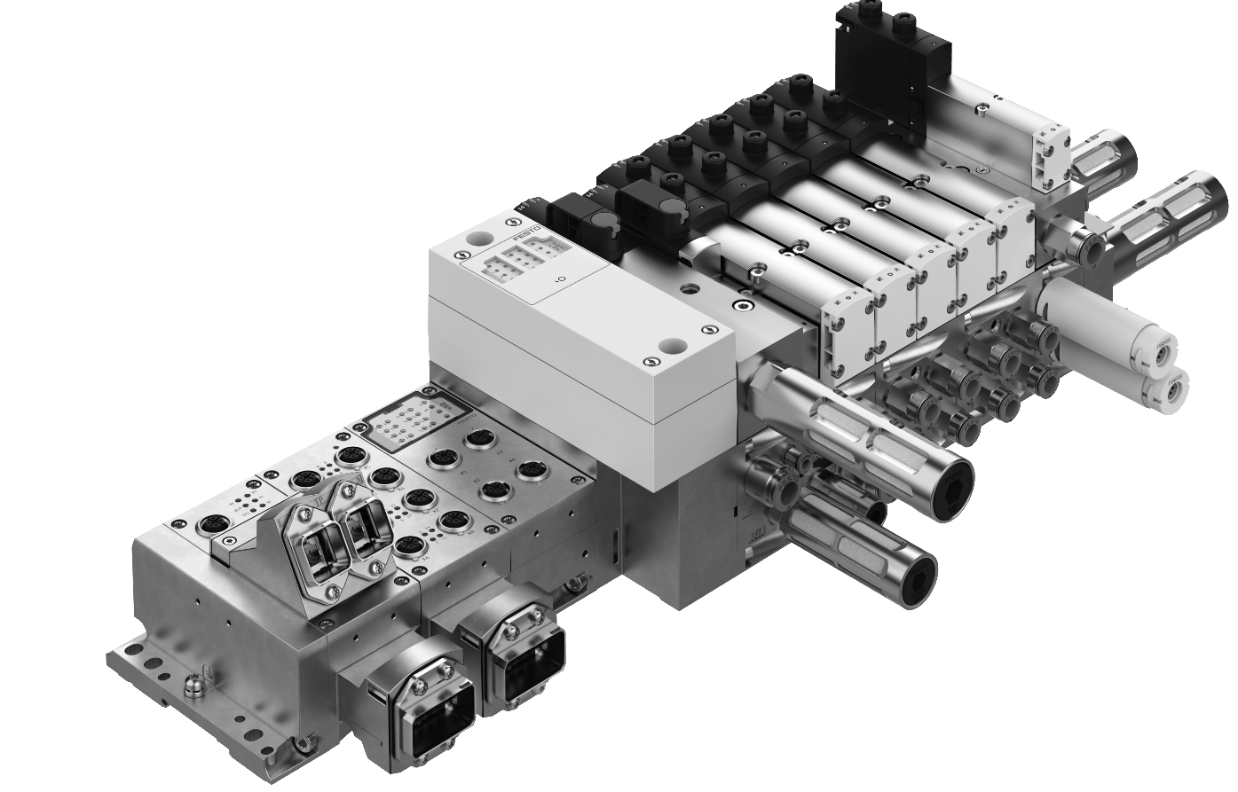

CPX/VTSA-F-CB
PROFINET-PROFISAFE
CONFIGURATION RULES

Slide 2

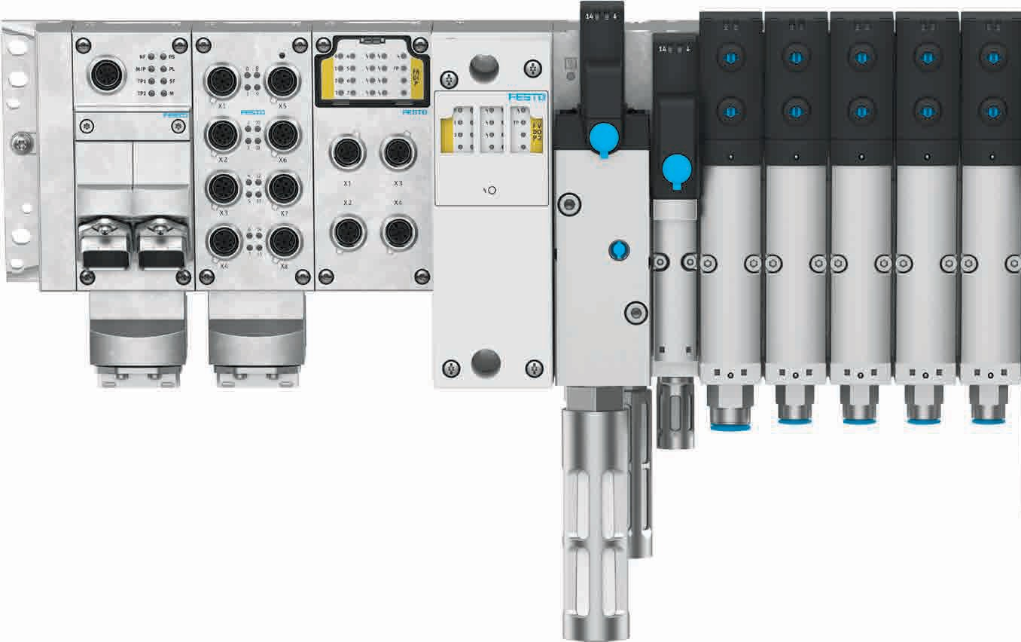
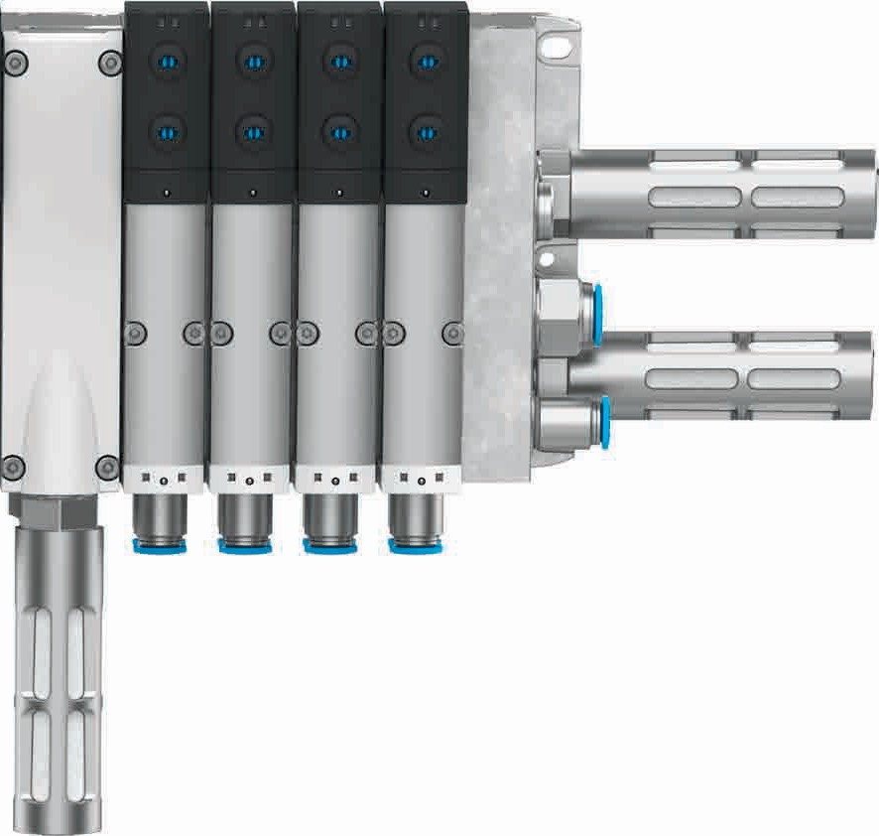
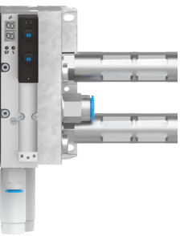
CPX/VTSA-F-CB – Brief description
Soft-start valve with integrated pressure switch allows diagnosis of exhaust condition
New pneumatic interfaces, optional with safety
Up to 3 Safety-Shutdown-Groups possible
with CPX interface:
PROFIsafe (integrated) or 3xM12 (external)
Realization of integrated control functions and flexible Safety-Shutdown-Groups, up to PL d cat. 3
Pilot air control valve with integrated pressure switch
Up to 4 voltage zones possible in pneumatic part
Serial communication in pneumatic part, up to 96 valves
Safe pilot air
Safe pneumatic supply air
Safe electric zone
Safe el. zone
Vacuum ejector with air saving circuit, optional with power eject pulse
integrated connection, parametrization via CPX-system

Slide 3
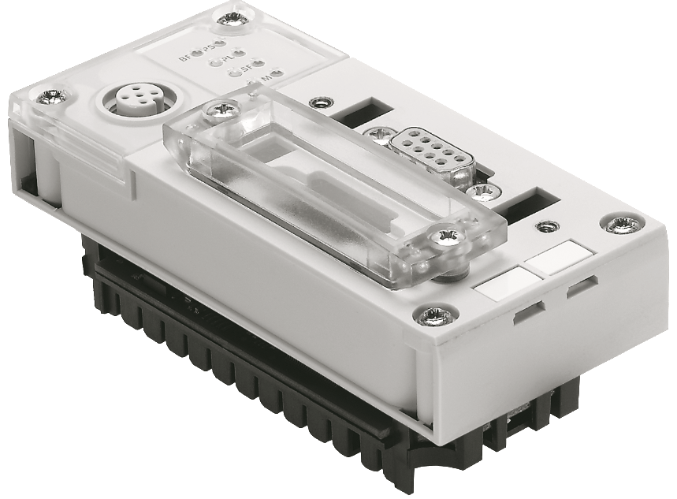
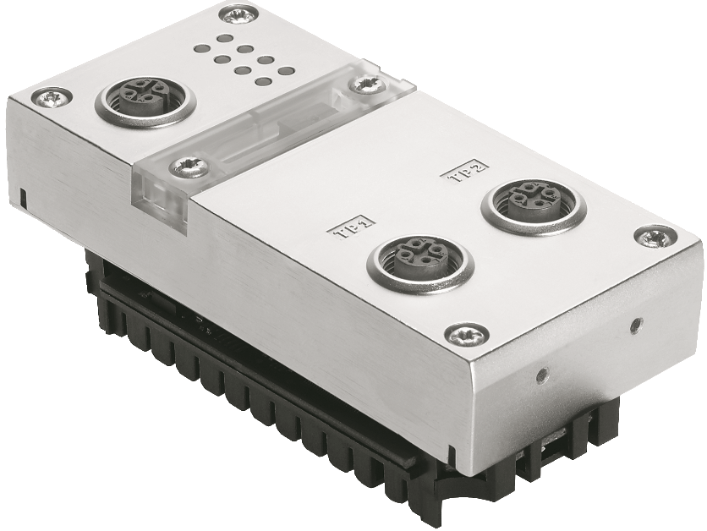
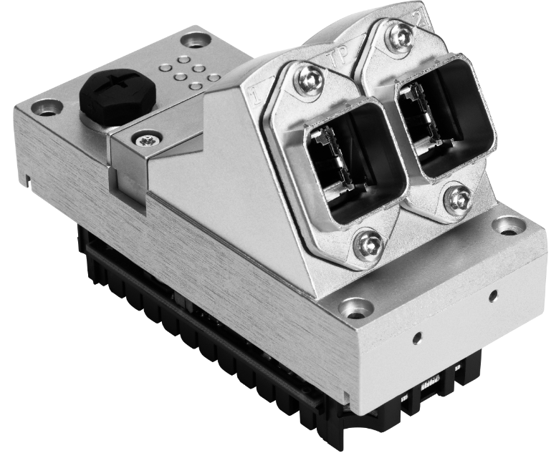


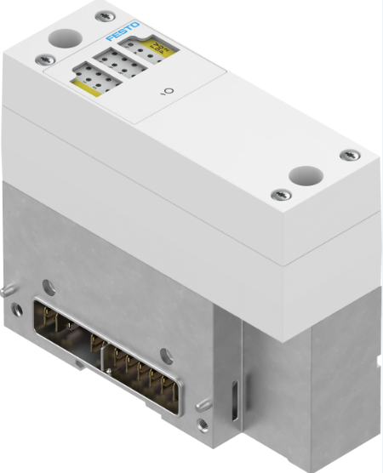
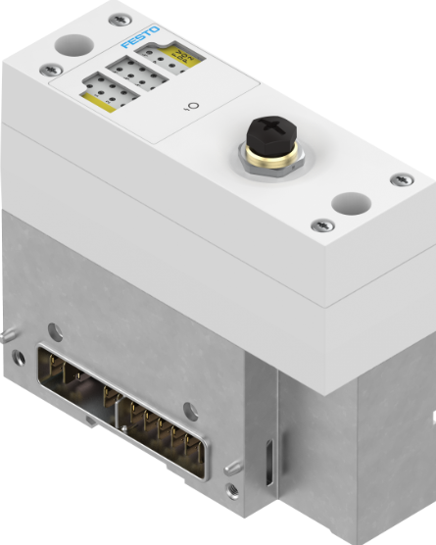

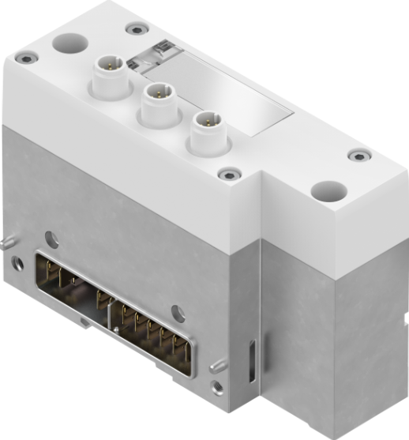
CPX/VTSA-F-CB: Possible field bus systems with VTSA pneumatic interfaces (Profinet)
FB 13
FB 43
FB 44 and FB45

Slide 4

Fieldbus
PROFINET

Slide 5
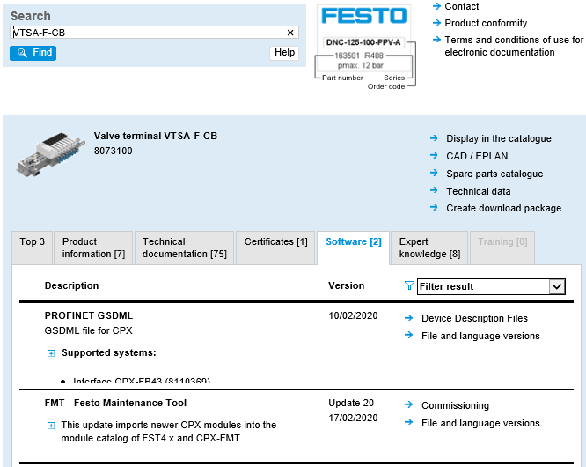


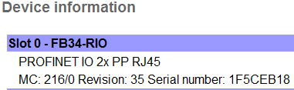
CPX | VTSA-CB configuration in TIA
What is new!
New GSDML File
New Firmware for bus node -> Rev 35
Update for Festo Maintenance Tool

Slide 6
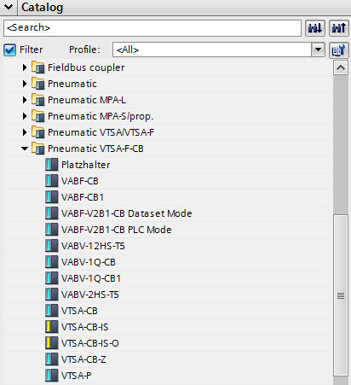
CPX | VTSA-CB configuration in TIA
New HW catalog
GSDML FB 3x/FB4x
There is a new entrey in the
Hardware Catalog in the TIA Portal
If the new GSDML File is installed
Standard Interface
Interface with 3 Saftey Zones
Interface with 2 Saftey Zones
+ 1 external Safety Output
Here you find the 3 new Interfaces,
Plus the address extender
Interface with 3 M12 for
External power supply
Address extender

Slide 7
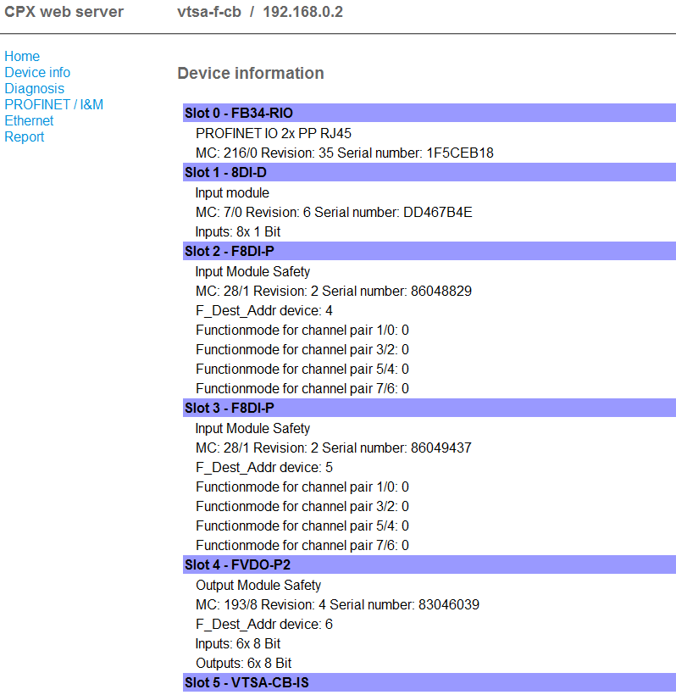
CPX | VTSA-CB configuration in TIA
Terminal configuration
You can check the set address in
the web server of the cpx bus node.
You see the safety address of the interface as FVDO-P2

Slide 8
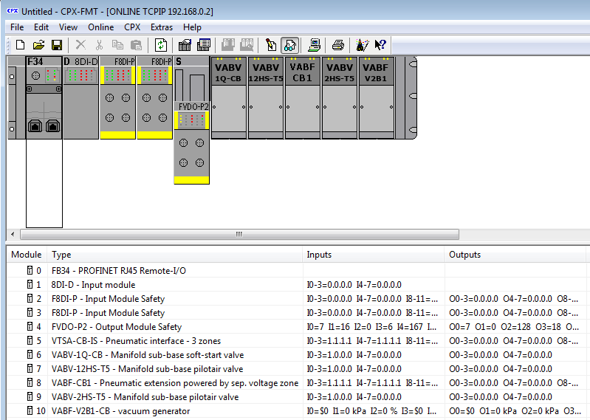
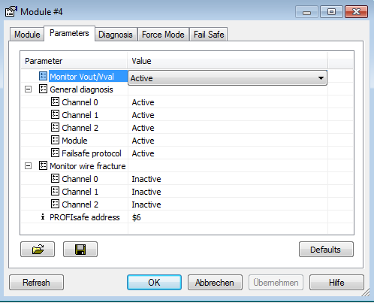
CPX | VTSA-CB configuration in TIA
Terminal configuration
You can also check the set address in
the FMT tool

Slide 9
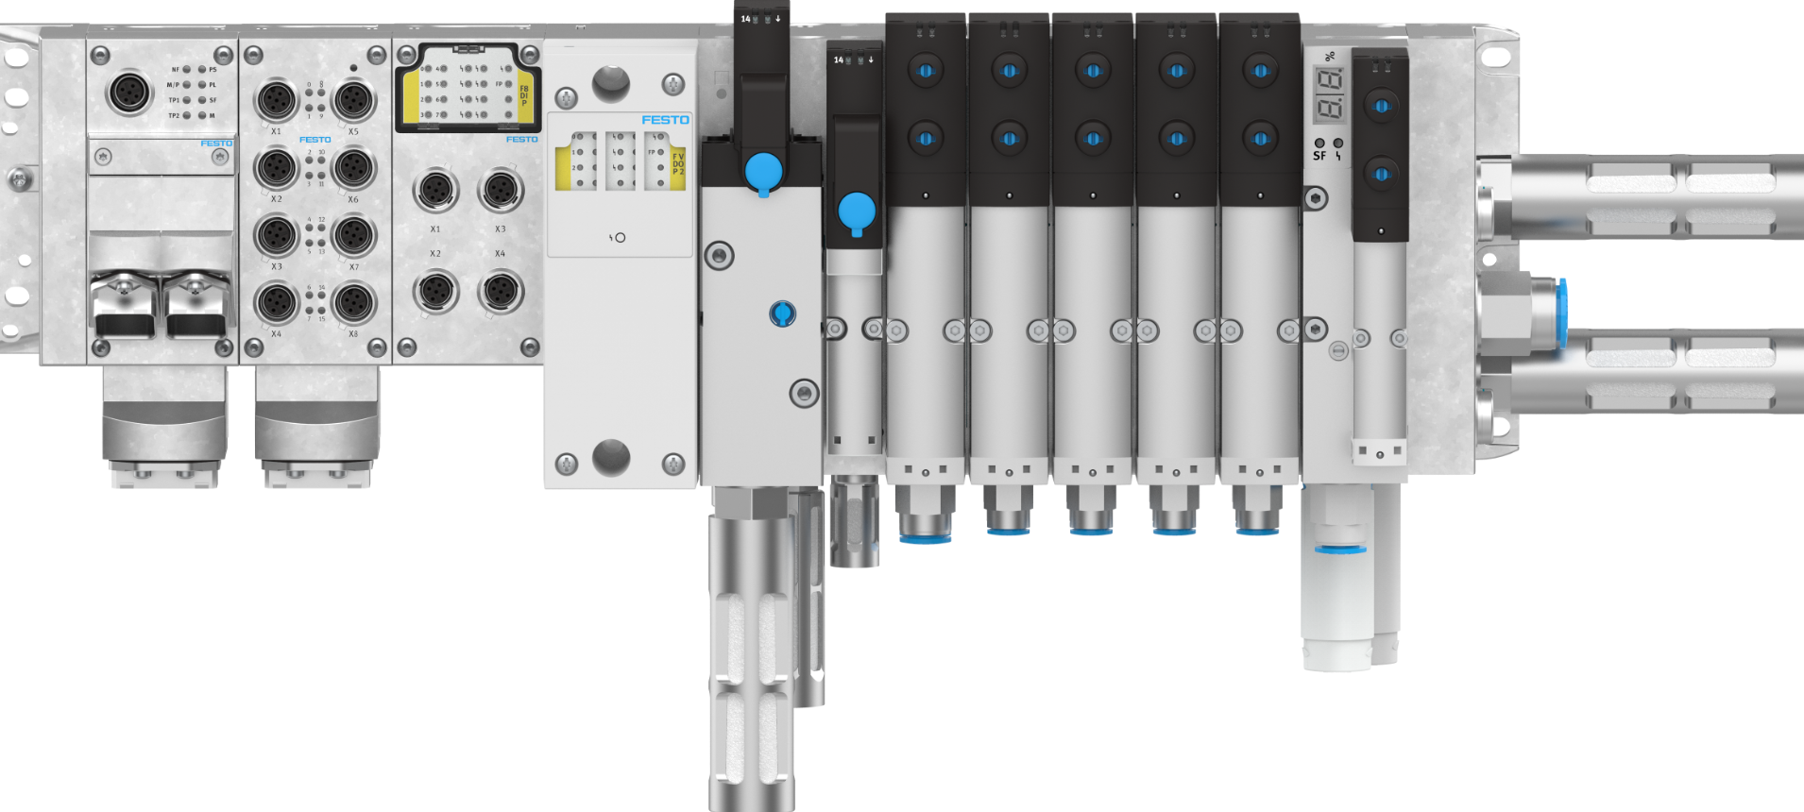
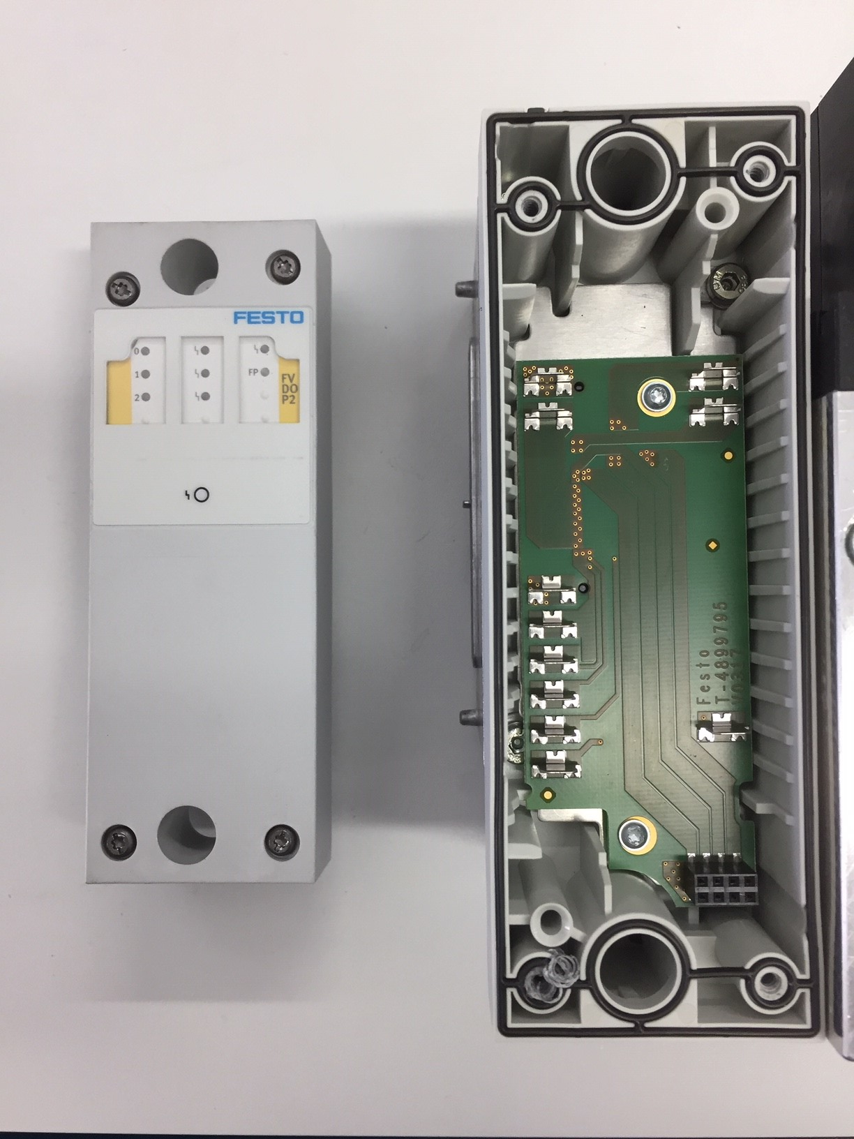
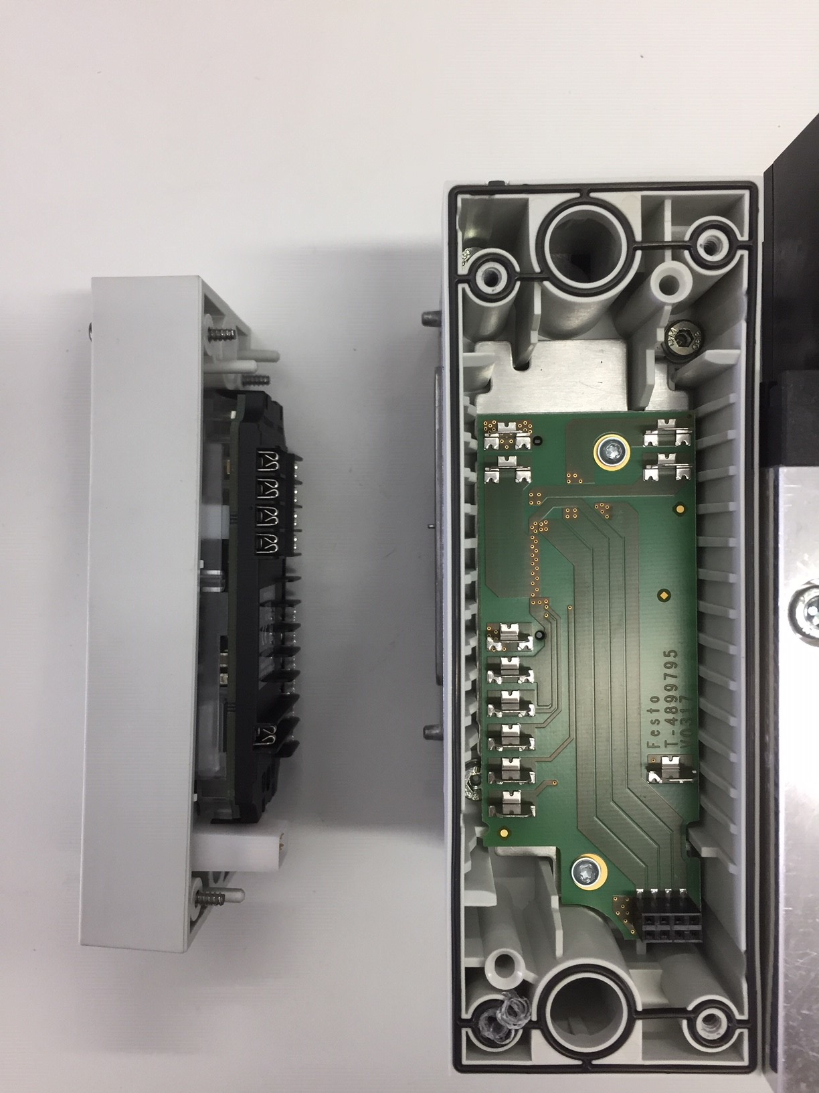
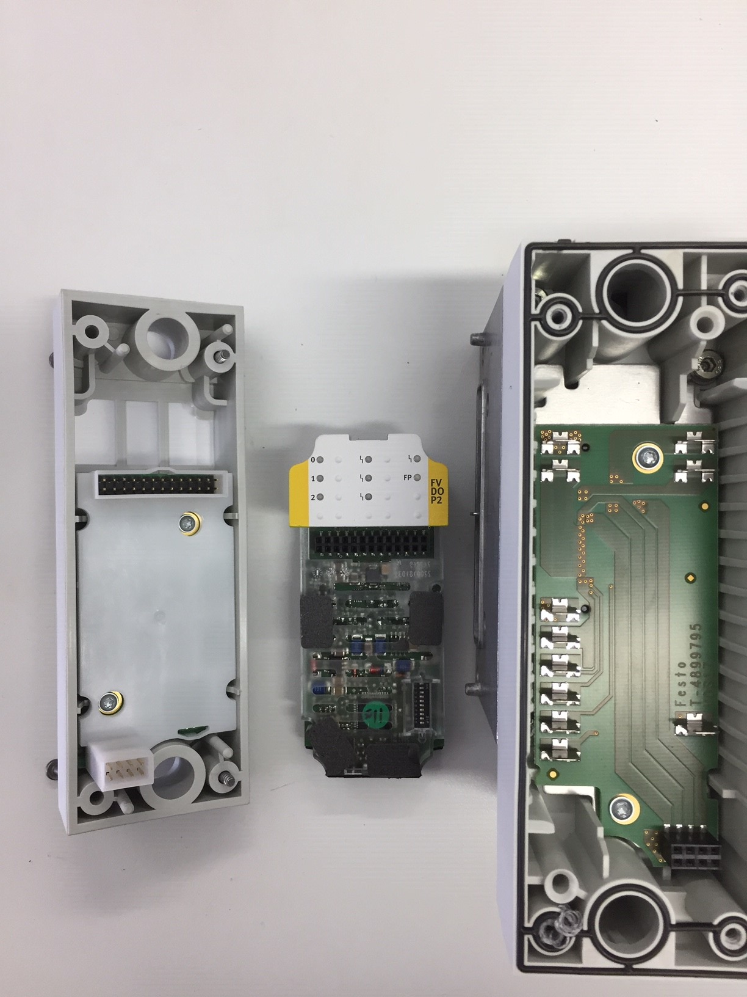
CPX | VTSA-CB configuration in TIA
Terminal configuration
To change the safety address in the interface, open the 4 screws and lift the cover up.
Then change the address to the value
You need, just like the FVDA-P2

Slide 10


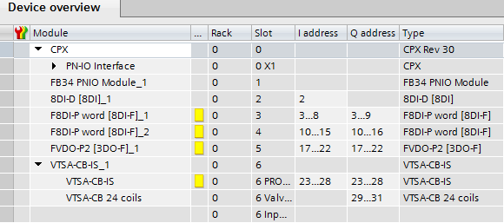
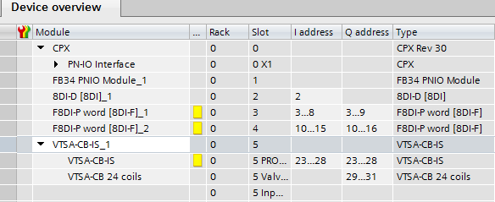


CPX | VTSA-CB configuration in TIA
Terminal configuration
Note: It is not allowed to put 2 FVDA-P2 into one terminal. Because the FVDA-P2 is integrated in the new
VTSA-F-CB Interface, another FVDA-P2 is not possible.
Furthermore, don`t forget to put in the right PROFIsafe address.

Slide 11
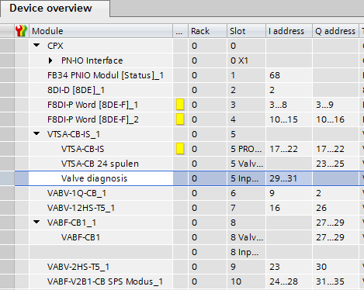
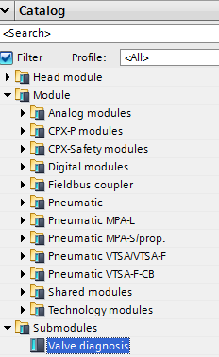
CPX | VTSA-CB configuration in TIA
Terminal configuration
Note: Because the existing VTSA-F with Diagnostic (= identcode „T“ in existing VTSA-F) is implemented in the new VTSA-F-CB Interface you have the possibility to get the diagnosis via EA cycling date of the interface.
If you DON’T need this function, just leave
this field blank

Slide 12

CPX | VTSA-CB configuration in TIA
Terminal configuration – Zone and standard valves
%I3.x…..
%I10.x…..
Profisafe - Zone1: %Q17.0 Zone2: %Q17.1 Zone3: %Q17.2
24 coils valve: %Q23.0……Q25.7
Channel duct 1 - coil 14: %Q2.0 Pressure switch: %I9.0
**
Channel duct 14 – coil 14: %Q26.0 Pressure switch: %I16.0
24 coils valve: %Q27.0……Q29.7
Channel duct 14 – coil 14 : %Q30.0
Pressure switch: %I23.0
%Q2.0
%Q23.0/1
%Q27.0/1
%Q26.0
%Q30.0
** Option for diagnosis via EA cycling date of the interface.
If you not need this function, just leave it blank.
%Q23.0…%Q25.7
%Q27.0…%Q29.7
VTSA-CB IT0SFO - 2020

Slide 13

CPX | VTSA-CB configuration in TIA
Terminal configuration – Zone and standard valves
The standard valves
14 = Q 23.0
12 = Q 23.1
14 = Q 23.2
12 = Q 23.3
And so on….. In total 3 byte

Slide 14
CPX | VTSA-CB configuration in TIA
Terminal configuration – Soft Start valve / Pilot air valve
To switch the Soft Start Valve, you need to switch the first bit of the output address. The pressure switch is on the first bit of
the input byte. If is there no pressure, it is on „1“.
14 = Q 2.0
PS = I 9.0
To switch the Pilot Air Valve, you need to switch the first bit of the output address. The pressure switch is on the first bit of
the input byte. If is there no pressure, it is on „1“.
14 = Q 26.0
PS = I 16.0

Slide 15
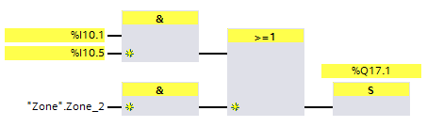
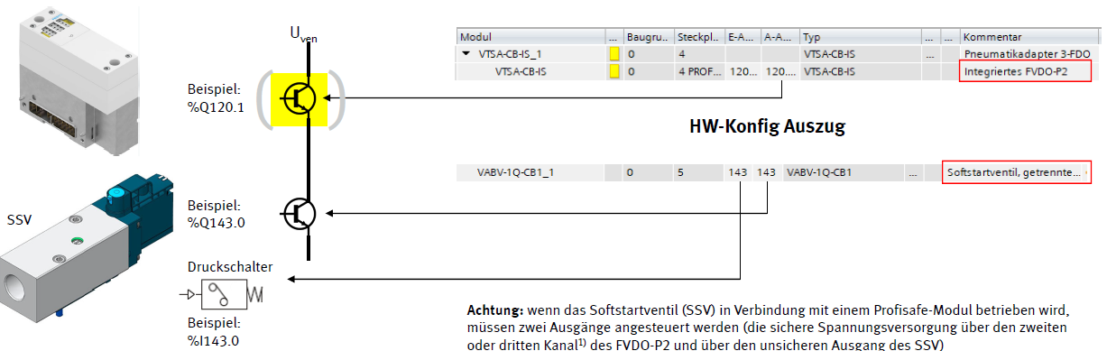
CPX | VTSA-CB configuration in TIA
CPX | VTSA-CB configuration in TIA
Activate a standard valve in a safe zone
Terminal configuration – Zone and standard valves
Example:
%Q17.1
17…
17…
Integrated FVDA-P2
Softstart valve
Example:
%Q2.0
Pressure switch
Attention: When using a Softstart valve (SSV) together with a PROFIsafe Interface
you must switch two outputs → the safety zone for power supply
and the standard output from the SSV.
Example:
%I9.0

Slide 16
Vacuum
Ejector

Slide 17
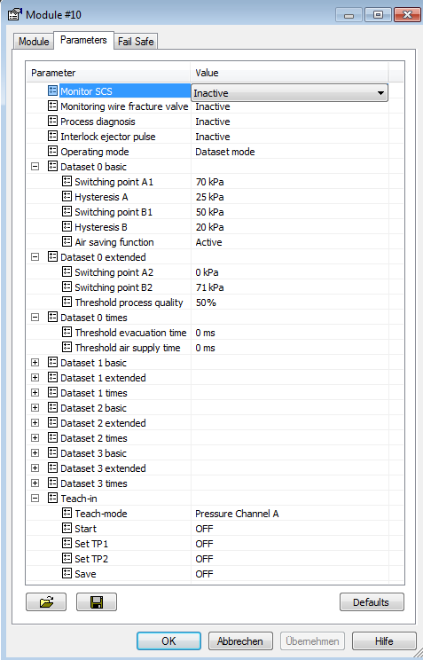

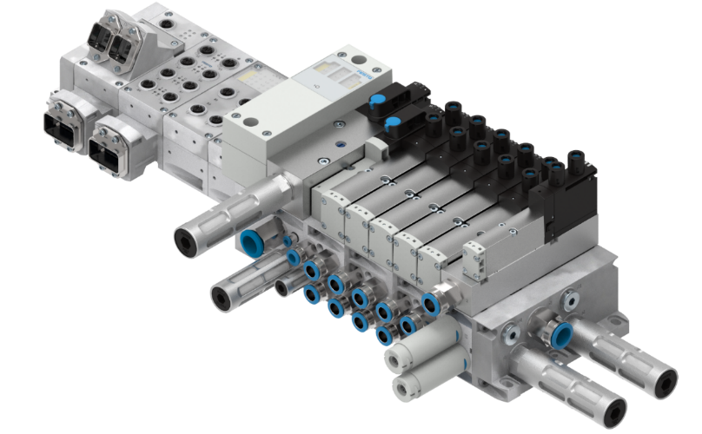
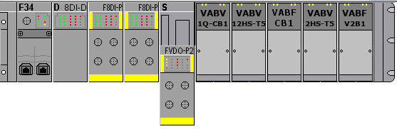
Vacuum-Ejector - Parameterization

Slide 18
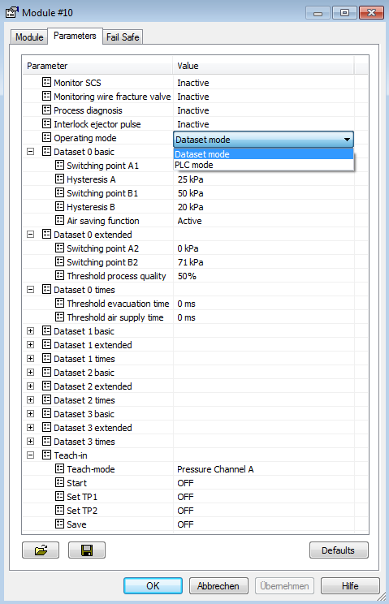
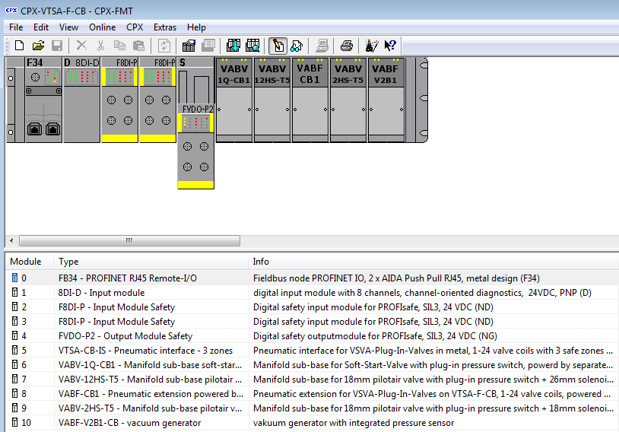
Vacuum-Ejector - Parameterization
Switch between „Dataset mode“
and „PLC mode“ is possible.

Slide 19
Vacuum-Ejector – EA-assignment „Dataset mode“
Input data (5 Bytes)
Error number
Definition | Process data | Default | Org
Switching output A | CH_A | 0 | Bit
Switching output B | CH_B | 0 | Bit
Open Load / short circut | OL/KZ Ven | 1 | Bit
Pressure | P | 0 | Byte
Warning process quality | Diag PG | 1 | Bit
Warning evacuation time | Diag EVAK | 1 | Bit
Warning blow off time | Diag Bel | 1 | Bit
Warning 2x evacuation time | Diag 2Eva | 1 | Bit
Warning 2x blow off time | Diag 2Bel | 1 | Bit
Warning parameter | Diag Para | 1 | Bit
Warning control parameter | Diag Regl | 1 | Bit
Warning Diag A1 | Diag A1 | 1 | Bit
Error number | Fehlernummer | 0 | Byte
process quality | Prozessguete | 0 | Byte
Diag
A1
Diag
Regl.
Diag
Para
Diag
2Bel
Diag
2Eva
Diag
Bel.
Diag
Evak
Diag
PG
Process quality in %
Pressure value P in kPa
OK/KZ
Ven
CH
B
CH
A
Valve diagnoses
0 no Error
1 Coil short circuit
or wire break
0 0 A&B < switching threshold
0 1 A > switching threshold
1 1 B > switching threshold
1 1 A&B > switching threshold
Output data (2 Bytes)
Parameter set
VAK
OnOff
ABW
OnOff
0 0 Selection Data set 0
0 1 Selection Data set 1
1 0 Selection Data set 2
1 1 Selection Data set 3
Vacuum On (Coil 12)
Blow off (Coil 14)

Slide 20
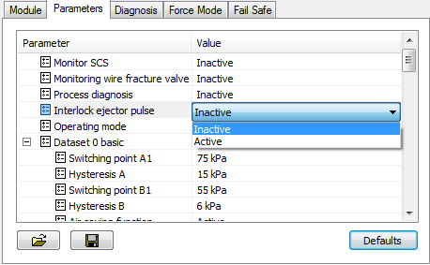
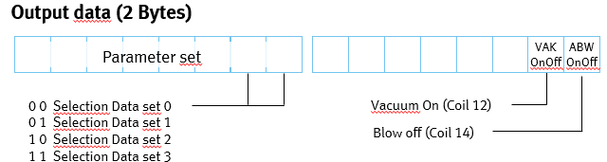
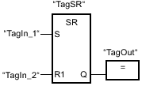


Vacuum-Ejector – How to start the process in Dataset mode
Check, if you need the interlock eject pulse switched „active“ or „inactive“. This you have to choose in the FMT tool. As default it is „Inactive“ and load the right parameter set as “INT”
To run trough the process, you have to follow these steps:
  Start the process with a „positive“ signal. You can use a „flank“ or „set“ the bit and „reset“. It is the bit „x.1“.
  To stop the vacuum, be sure bit „x.1“ is „0“.
  Then you need a positive flank on the eject pulse, like you do it on the start.
  If the eject pulse on bit “x.0“ gives a negative flank to the system, the complete process is finish.
Parameter: %QB32
PLC Modus
Vacuum on: %Q31.1
Eject pulse: %Q31.0

Slide 21
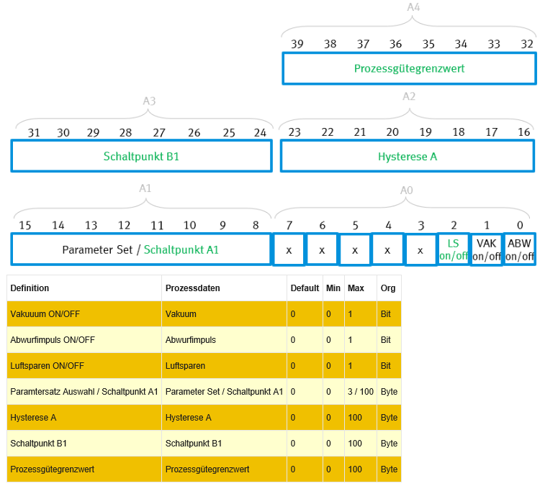
Vacuum-Ejector – EA-assignment „PLC mode“
Output data (5 Bytes)
Process quality
Input data (5 Bytes)
Set Point B1
Hysterese A
Error number
Diag
A1
Diag
Regl.
Diag
Para
Diag
2Bel
Diag
2Eva
Diag
Bel.
Diag
Evak
Diag
PG
Process quality in %
Set Point A1
Pressure value P in kPa
OK/KZ
Ven
CH
B
CH
A
Valve diagnoses
0 no Error
1 Coil short circuit
or wire break
0 0 A&B < switching threshold
0 1 A > switching threshold
1 1 B > switching threshold
1 1 A&B > switching threshold

Slide 22

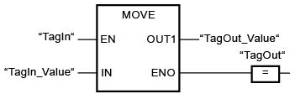

Vacuum-Ejector – How to start the process in PLC mode
Check, if you need the interlock eject pulse switched „active“ or „inactive“. This you have to choose in the FMT tool. As default it is „Inactive“ and load the right parameter set as “INT”
Load the parameter like hysteresis and setpoint with, for an example “MOVE” command, into the output cycling data of the vacuum
To run trough the process, you have to follow these steps:
  Start the process with a „positive“ signal. You can use a „flank“ or „set“ the bit and „reset“. It is the bit „x.1“.
  To stop the vacuum, be sure bit „x.1“ is „0“.
  Then you need a positive flank on the eject pulse, like you do it on the start.
  If the eject pulse on bit “x.0“ gives a negative flank to the system, the complete process is finish.
Value in
„HEX“
%QB32
16#3C
%QB34
%QB33
%QB31
Vacuum on: %Q31.1
Eject pulse: %Q31.0
Air saving function: %Q31.2

