Slide 1
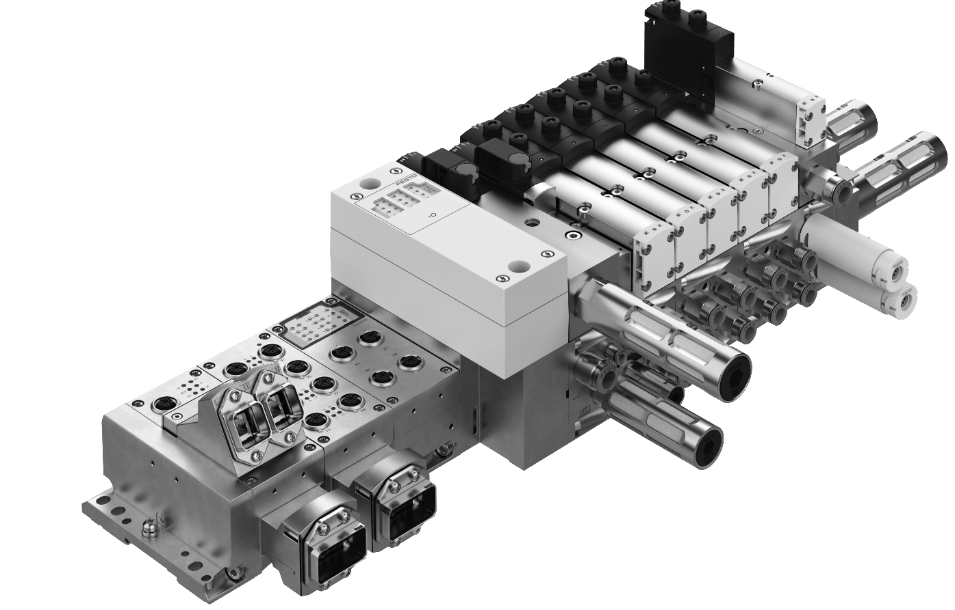

CPX/VTSA-F-CB
ETHERNET-IP/ETHERCAT
CONFIGURATIONE RULES

Slide 2
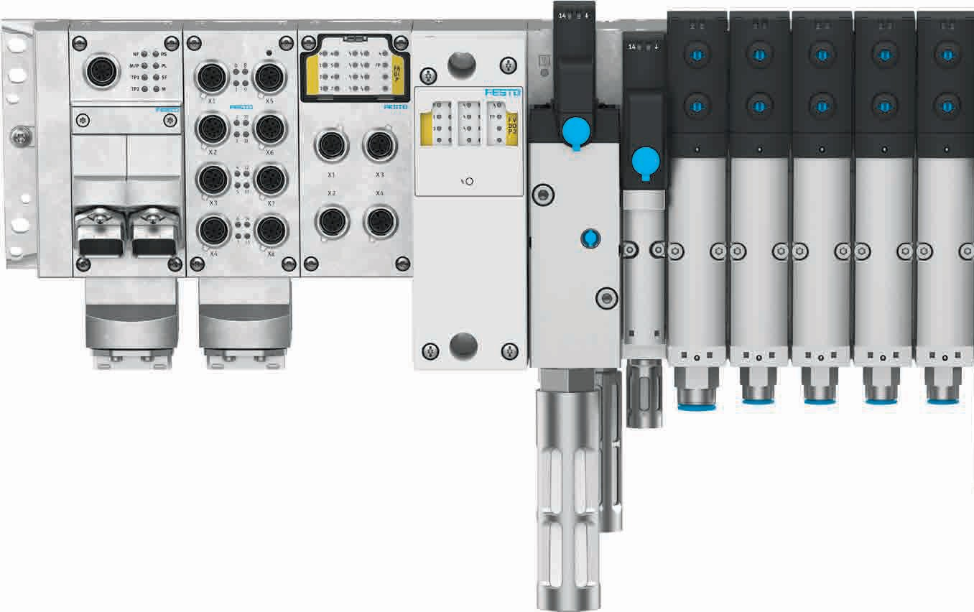
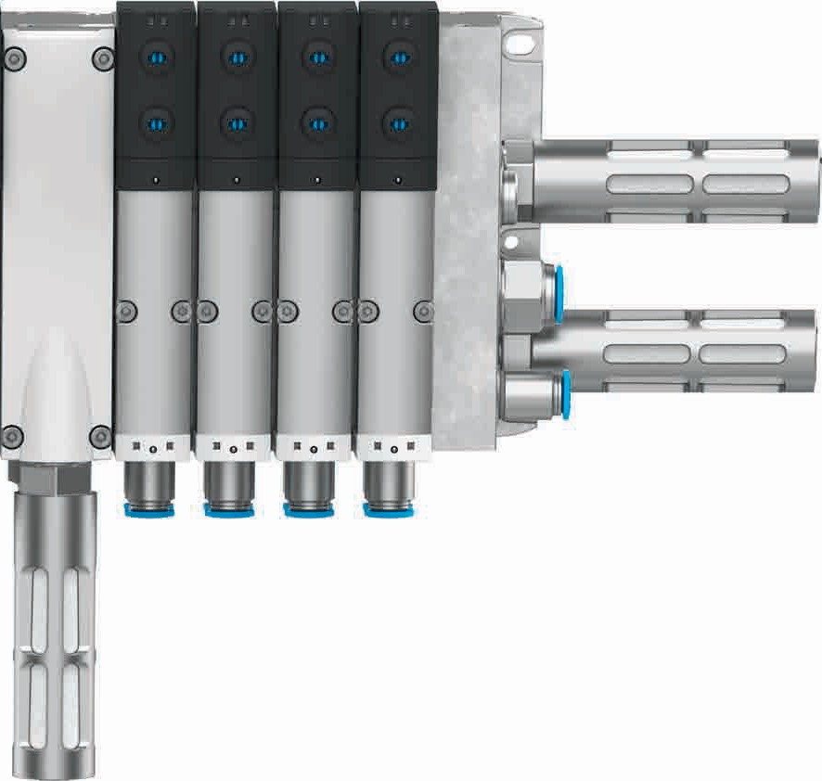
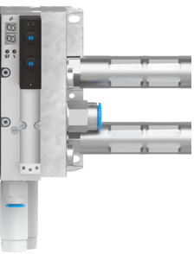
CPX/VTSA-F-CB – Brief description
Soft-start valve with integrated pressure switch allows diagnosis of exhaust condition
New pneumatic interfaces, optional with safety
Up to 3 Safety-Shutdown-Groups possible
with CPX interface:
3xM12 (external)
Realization of integrated control functions and flexible Safety-Shutdown-Groups, up to PL d cat. 3
Pilot air control valve with integrated pressure switch
Up to 4 voltage zones possible in pneumatic part
Serial communication in pneumatic part, up to 96 valves
Safe pilot air
Safe pneumatic supply air
Safe electric zone
Safe el. zone
Vacuum ejector with air saving circuit, optional with power eject pulse
integrated connection, parametrization via CPX-system

Slide 3
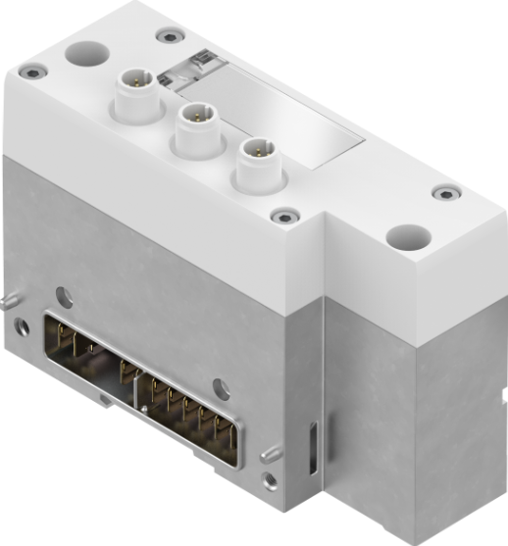
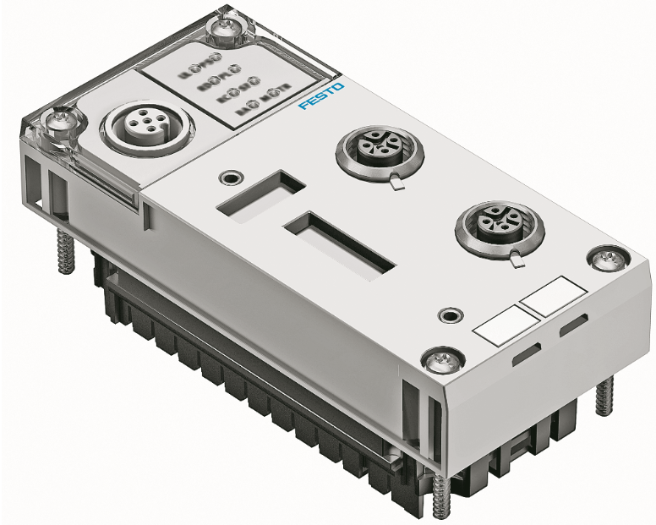
CPX/VTSA-F-CB: New VTSA pneumatic interfaces with FB36 (Ethernet-IP)
Pneumatic interface with
external supply
of 3 potentials (M12).
Incl. output driver
for 24 coils.
diagnosis via
IO tags

Slide 4
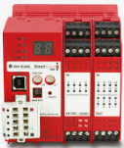
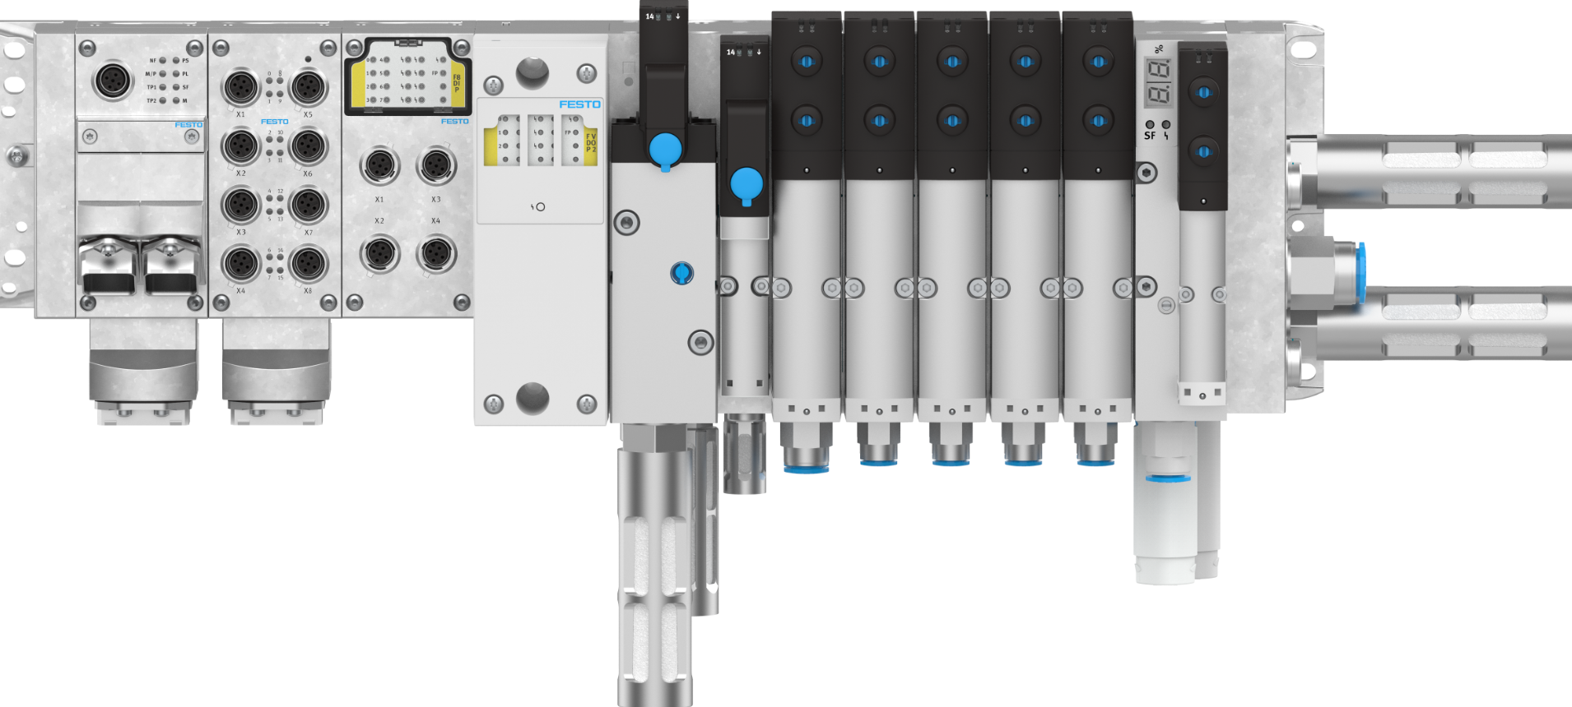


CPX/VTSA-F-CB with serial communication, 3xM12 for zones and vacuum integration
CIP Safety Output modul
This is an example. It is also
possible with other safety switches.

Slide 5
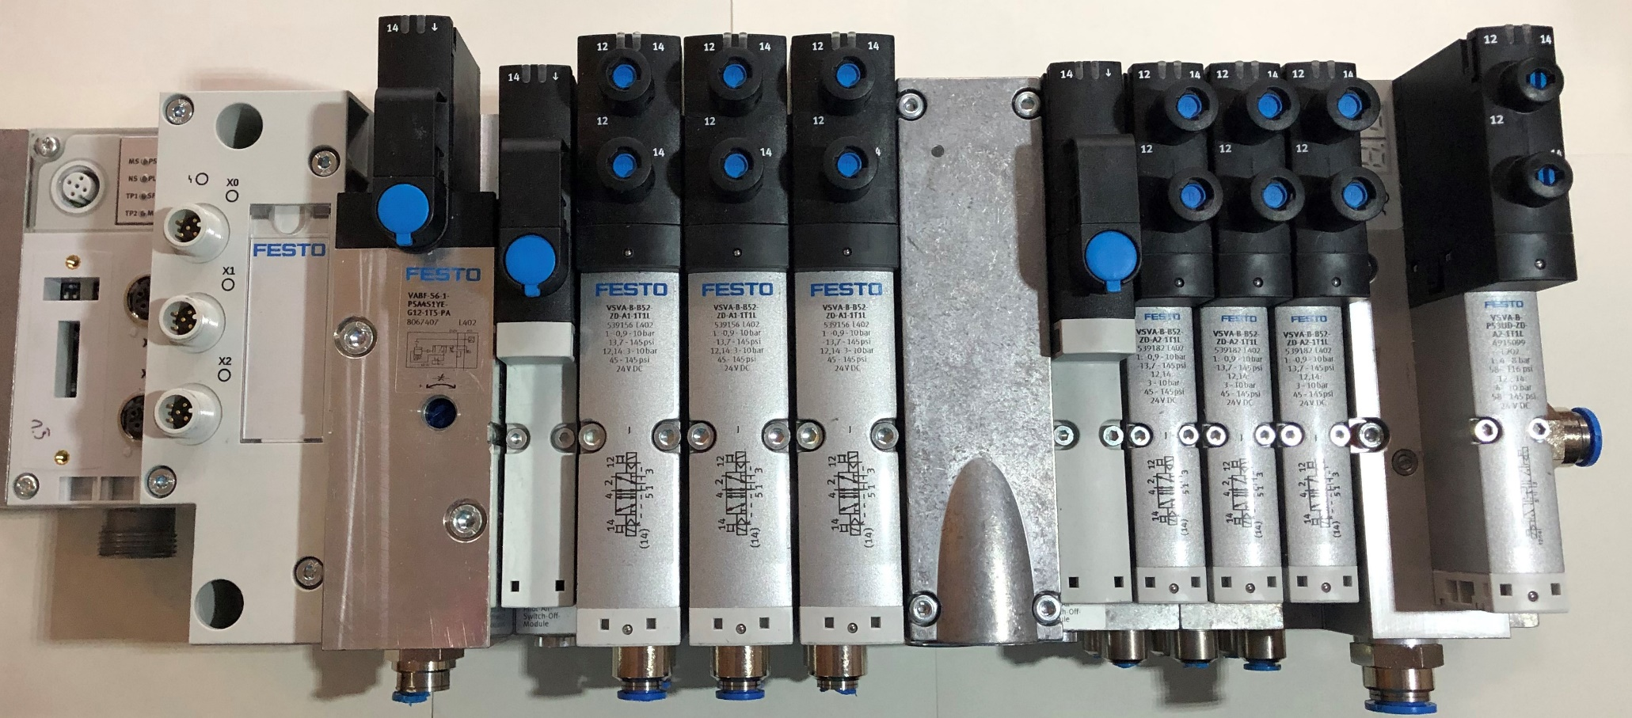
CPX/VTSA-F-CB with serial communication and safe zones
Power
Zone 2
Internal serial CBUS communication
Power
Zone 2
Operating Soft-start valve:
Pressure Integrated control and integrated pressure switch feedback via CBUS
Pilot Pressure:
Integrated control and integrated pressure switch feedback via CBUS
Pilot Pressure:
Integrated control and integrated pressure switch feedback via CBUS
Power
Zone 1
Power
Zone 3

Slide 6
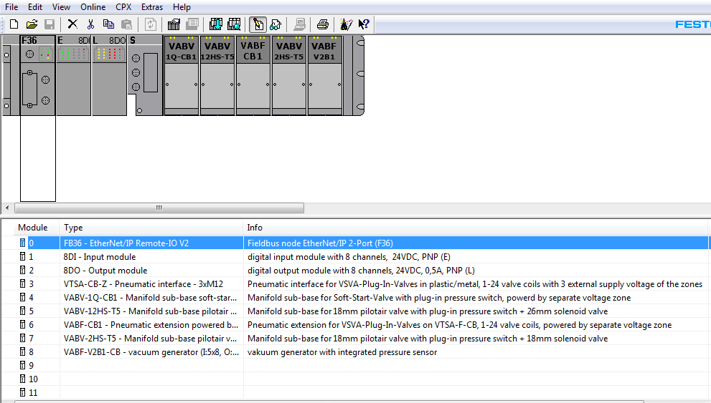
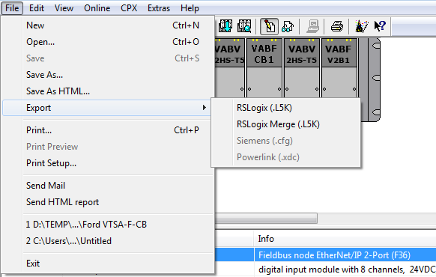
CPX | VTSA-F-CB configuration for FB36
Terminal configuration
A way to configure a terminal in a Rockwell enviroment, is to use the .L5K export function of the FMT tool
  Go „online“ and upload the configuration in to the FESTO Maintanance (FMT) or
  Configure „offline“
Download a manual for the export process here

Slide 7
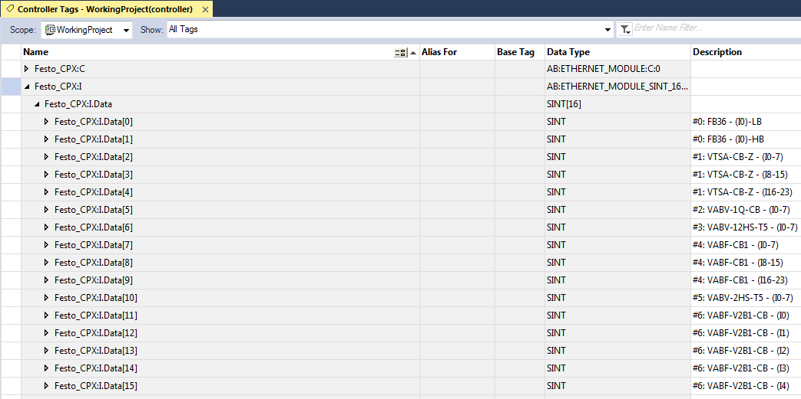
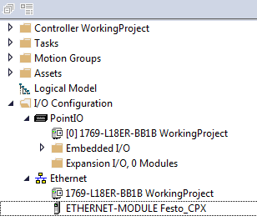
CPX | VTSA-F-CB configuration for FB36
Terminal configuration

Slide 8
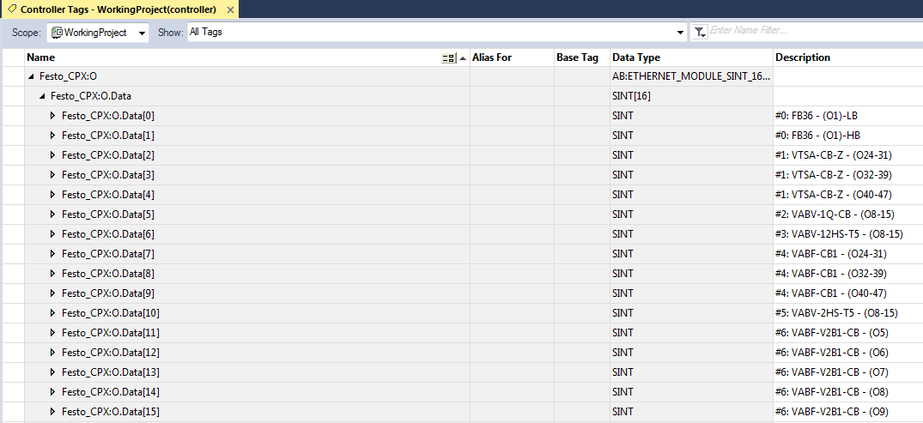

CPX | VTSA-CB configuration for FB36
Terminal configuration
Soft Start Valve (Z1)
Pilot Air (Z0)
Address Extension (Z2)
Pilot Air (Z2)
Vacuum Ejector (Z2)

