Slide 1
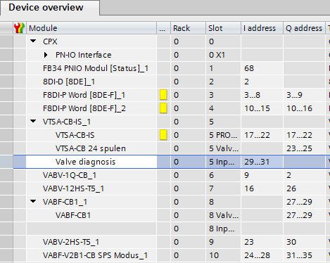
CPX | VTSA-CB configuration in TIA
Terminal configuration – Zone and standard valves
%I3.x…..
%I10.x…..
Profisafe - Zone1: %Q17.0 Zone2: %Q17.1 Zone3: %Q17.2
24 coils valve: %Q23.0……Q25.7
Channel duct 1 - coil 14: %Q2.0 Pressure switch: %I9.0
**
Channel duct 14 – coil 14: %Q26.0 Pressure switch: %I16.0
24 coils valve: %Q27.0……Q29.7
Channel duct 14 – coil 14 : %Q30.0
Pressure switch: %I23.0
%Q2.0
%Q23.0/1
%Q27.0/1
%Q26.0
%Q30.0
** Option for diagnosis via EA cycling date of the interface.
If you not need this function, just leave it blank.
%Q23.0…%Q25.7
%Q27.0…%Q29.7

